Slide 1
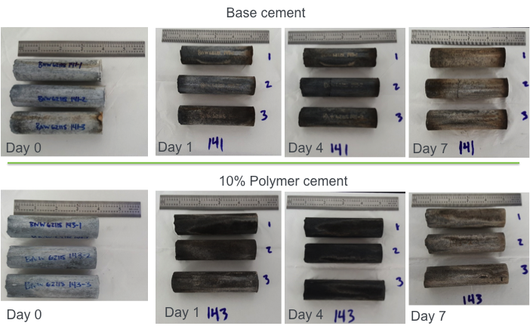
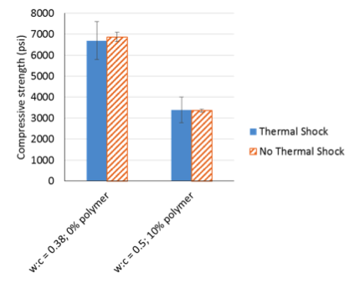
Task 4: Cement composites bulk thermal properties
Polymer-Cement Composites
Task 4.2: Resistance to Thermal Stress
250C/24h followed by heat quenching for 15min at 25C
Repeat cycle 6 times. Triplicate samples
Both, control cement and 10wt% polymer-cement composites manifest similar color changes. One of the control cement samples fractured transversally
Task 4.3: Compressive strength after thermal stress
Polymer-cement composites show compressive strength values identical to original samples(3300psi)
Control samples undergo a slight decrease in compressive strength though not statistically different to original samples
1
Notes:
Labs should only fill out the relevant quarters. Please feel free to expand this to 2 slides if necessary.

Slide 2
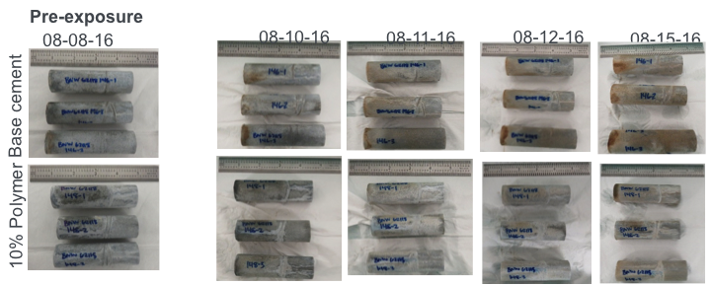
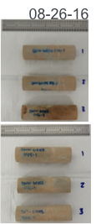
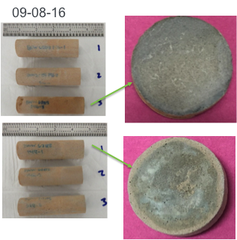
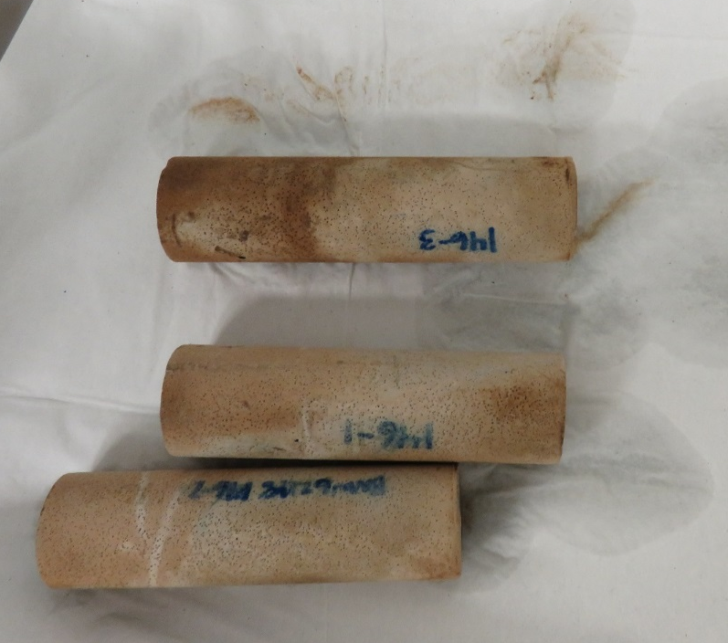
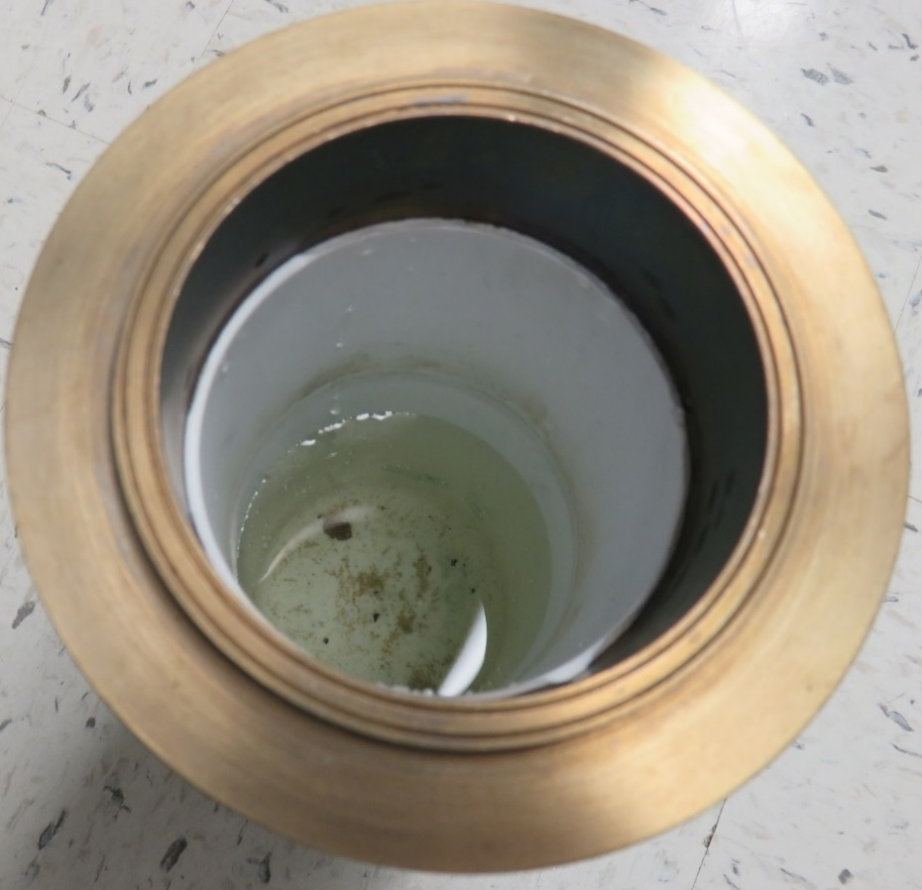
Task 5: Cement composites bulk chemical properties
Polymer-Cement Composites
Task 5.1: Resistance to acid attack
Samples were immersed in 1 wt.% NaCl brine containing H2SO4 with pH 2.0 (500mL), T=90C, one month exposure
Fluid was changed out either daily or after 36 hours and pH measured
Over 11L of H2SO4 were exchanged
From a pH perspective both cements seem to be able to consume most of the available acid.
Temperature seems to play an important role in the reaction (see pH values at day 15 where heaters were not turned on)
A reaction front is observed clearly on the polymer-cement composites
Sediment was observed in both control and polymer-cement samples(photos at right)
2
2
2
Notes:
Labs should only fill out the relevant quarters. Please feel free to expand this to 2 slides if necessary.

Slide 3
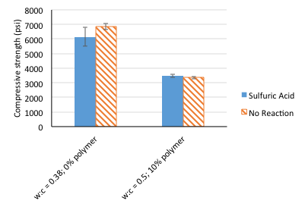
Task 5: Cement composites bulk chemical properties (cont.)
Polymer-Cement Composites
Analysis of compressive strength after mineral acid attack
Though exposed to pH=2 (instead of pH=1) brine solutions of H2SO4 polymer-cement composites show compressive strength values identical to original samples (3300psi)
Control samples undergo 13% decrease in compressive strength
3
3
3
Notes:
Labs should only fill out the relevant quarters. Please feel free to expand this to 2 slides if necessary.

Slide 4
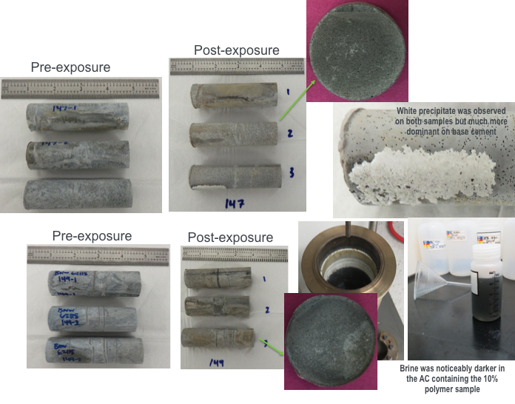
Task 5: Cement composites bulk chemical properties (cont.)
Polymer-Cement Composites
Task 5.2: Resistance to high CO2 in brine concentrations (performed at NETL)
Samples were immersed in 1 wt.% NaCl brine pressurized with 3000psi of supercritical CO2 at 250C
Samples fully immersed in 1 wt.% NaCl brine (750 mL)
Samples exposed for one month by triplicate
Two polymer-cement composite samples fractured transversally
Reaction fronts in both base cement and composite cements were similar in width
Base cement
10% Polymer
4
4
4
Notes:
Labs should only fill out the relevant quarters. Please feel free to expand this to 2 slides if necessary.

Slide 5
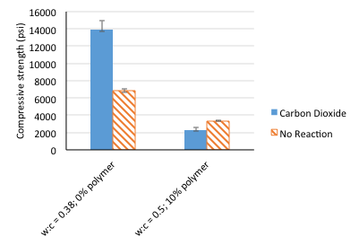
Task 5: Cement composites bulk chemical properties (cont.)
Key Accomplishments and Milestones: Polymer-Cement Composites
Analysis of compressive strength and structural changes after CO2 attack
Exposure of polymer-cement composites reduce the compressive strength values identical by 30% (3300 to 2350psi)
Control samples undergo a dramatic increase in compressive strength potentially associated to conversion of Ca(OH)2 to Ca and Ca-Si carbonates.
The fact that this is not the case for the polymer-cement composites which undergo an actual reduction in compressive strength could be associated to a lower level of penetration of CO2 in the cement matrix though not evident in the pictures
Work to understand this effect is ongoing.
5
5
Notes:
Labs should only fill out the relevant quarters. Please feel free to expand this to 2 slides if necessary.

